Slide 1


Slide 2

Sachin Bisht 1516110162
Richansi Chauhan 1516110155
Saumya Priya Negi 1516110178
Shashank Singh 1516110181

Slide 3

Maintaining the attendance is essential in every one of the foundations for checking the performance of students. Each organization has its own technique. Traditionally student’s attendance is taken physically by utilizing participation sheet, given by the employee in class.Framework is such that it uses face detection and recognition algorithms which automatically detect and registers student attending on a lecture.

Slide 4
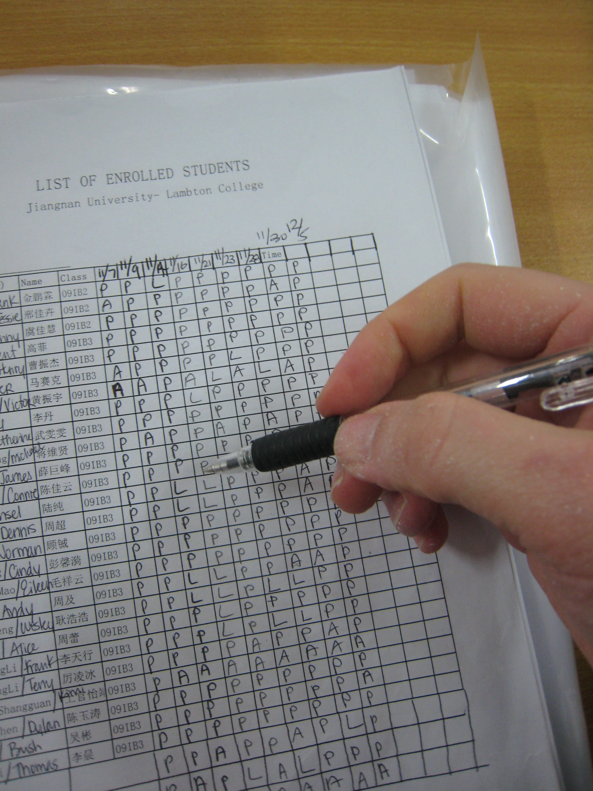

Slide 5

Facial Recognition refers to identifying or verifying an individual based upon facial features
It is categorized into 2 types-
  Face Verification
  Face Identification

Slide 6


Slide 7
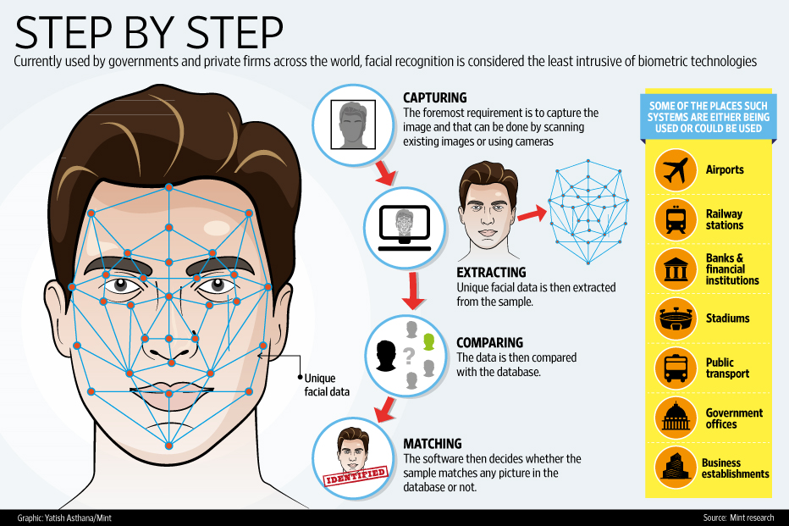

Slide 8


Slide 9


Slide 10

Saves Time and Effort
Paper-Free
Secure and Acessible to all System
Can be used for Security Purpose in Organizations and Security Zones

Slide 11

Hardware Requirement-
Camera
Secondary Memory
Software Requirement-
OpenCV
MySQL
Python Programming Language

Slide 12


Slide 13


Slide 14


Slide 15


Slide 16


